Slide 1
Data Validation for Data Science EuroPython July 2022 Tutorial https://github.com/NatanMish/data_validation
Natan Mish
Machine Learning Engineer

Slide 2
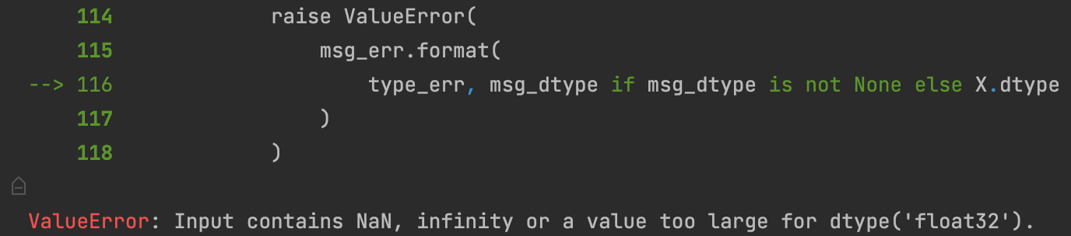

Looks familiar?

Slide 3
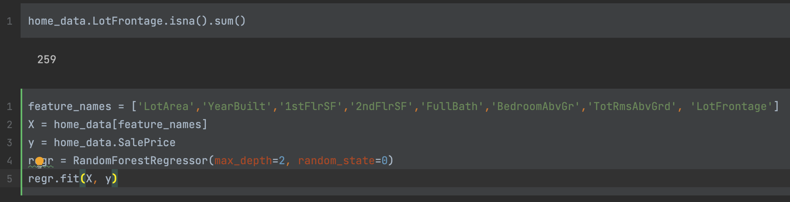

Slide 4
About me
Machine Learning Engineer @ Zimmer Biomet
MSc in Social Data Science from the London School of Economics
Previously worked in the finance and fintech industries
Also…
I like finding bugs(especially if they’re my own making)

Slide 5
Agenda
Who needs data validation anyway?
Validation in databases using Great Expectations
Validation in training pipelines using Pandera
Validation in model serving using Pydantic
We will not cover
How to optimize your validation holdout dataset for deep learning models

Slide 6
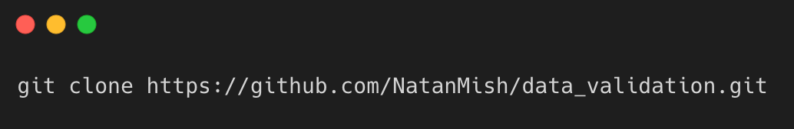

Tutorial Instructions
Alternatively, click the ”Open in Colab” link straight from the notebook on GitHub.
Environment requirements: Python 3.8 and up with Jupyter installed, and Git for cloning the tutorial repo.
Clone the repository from GitHub using the CLI:
Follow the instructions in the notebook

Slide 7
Dataset – Ames house prices prediction
As featured in Kaggle house prices prediction competition
Simple to use and understand, used extensively in tutorials and courses.
Variety of types of features – numerical, strings, categorical (80 different fields).
Target variable is the house price.

Slide 8
What does Data Validation mean?
Data validation is the practice of checking the integrity, accuracy and structure of data before it is used.
Useful in any kind of work that uses data – software development, research, accounting, military intelligence.
We can validate types, ranges, consistency and incorporate business logic to make our project more robust.

Slide 9
How can data become invalid?
Human error – for example when tagging labels for training models.
Errors in the data generating code.
Outdated/expired data sets.
Bugs or changes in upstream data pipelines.

Slide 10
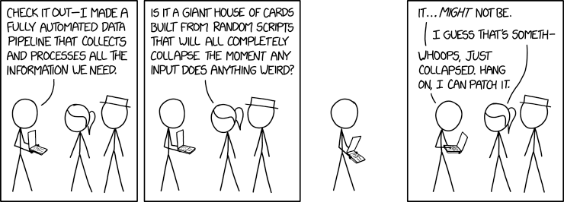
Why validate your data?

Slide 11
1. Data integrity
Helps align the integrity throughout the entire system.
This only relates to the logical integrity of the data, and not the physical one.

Slide 12
2. Reliability
Prevent and detect bugs from the very first interaction with the data.
Prevent and detect bugs throughout the data science product life cycle.
Minimize surprises – know what input to expect and where to expect it.
Can help with an early detection of a data drift.

Slide 13
3. Readability
Harness Python’s type hints feature
Some IDEs will highlight if something is wrong before we actually run anything.

Slide 14
4. Familiarity
Implementing validation steps will force us to get to know our data better.
This helps us as data professionals gain domain knowledge.
Find out what are the limits, gaps, types and ranges our database consists of.
Some of the tools allow for creating automated data documentation.

Slide 15
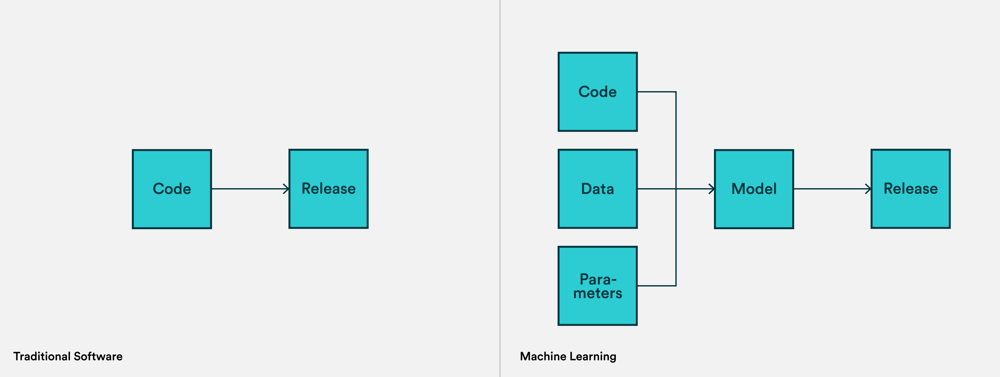
Key part in the MLOps process
https://valohai.com/blog/difference-between-devops-and-mlops/
Notes:
https://towardsdatascience.com/not-yet-another-article-on-machine-learning-e67f8812ba86

Slide 16
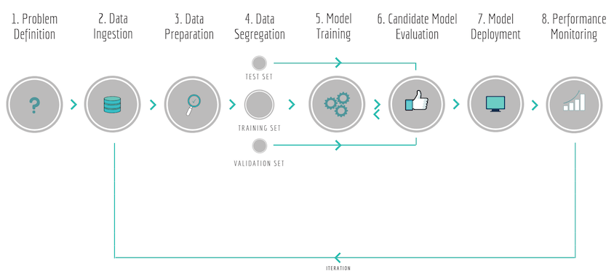
At what point in the model lifecycle should we implement data validation?
Here!
https://towardsdatascience.com/not-yet-another-article-on-machine-learning-e67f8812ba86
Notes:
https://towardsdatascience.com/not-yet-another-article-on-machine-learning-e67f8812ba86

Slide 17



Hands on tutorial
Dataset validation with
Training pipelines validation with
Model serving validation with
*Each of the tools could potentially be used for any of the components

Slide 18
Database validation with Great Expectations
Follow the instructions in the notebook.

Slide 19
Training pipeline validation with Pandera
Follow the instructions in the notebook.

Slide 20




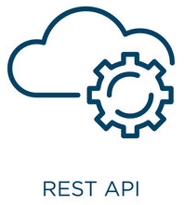






Serving data validation with Pydantic
Training pipeline
Serving/Inference layer
Follow the instructions in the notebook.
model
Application

Slide 21
To wrap things up…

Slide 22
Thank you for listening!
Any questions?

